Slide 1

Social Security Secrets:
10 Questions You Didn't Know You Needed to Ask
AMACFOUNDATION.ORG | 888.750.2622 | SSADVISOR@AMACFOUNDATION.ORG
Notes:
Thank you for joining us today. I am Andy Brush with the AMAC Foundation, Social security advisory service. I would like to welcome you to our SS webinar.
I'm also joined by Deb Dunlap and Mark Hendelson. We have a webinar full of great information on Social Security. We are going to answer 10 questions you didn't know you needed to ask.
I am going to kick it off, then Deb will take over the second half. Mark is our anchor and will handle all the QAs. If you have any questions, please put them in the chat and Mark will answer them at the end of the presentation. If you have a specific question about a personal situation (or a friends), you may want to consider sending that directly to us at AMAC. Our contact information will be available at the end of the session.
I will give it about a minute for everyone to join and then we will get started.

Slide 2
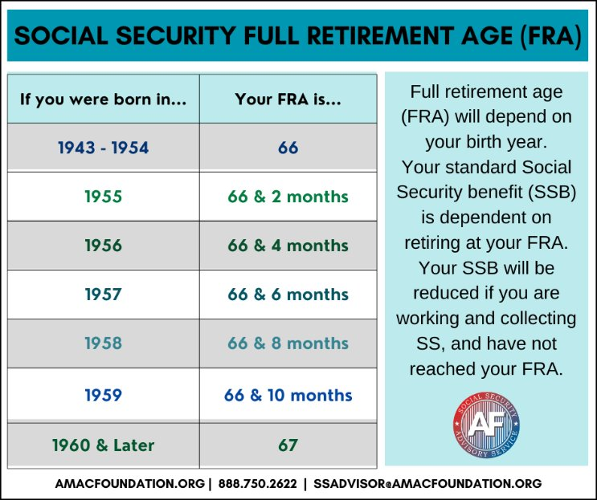
1. What is my Social Security Full Retirement Age (FRA) and why
is that important to know?
AMACFOUNDATION.ORG | 888.750.2622 | SSADVISOR@AMACFOUNDATION.ORG
Notes:
Again thank you for joining us. We are going to answer 10 Social Security Questions you may not have known to ask.
The first question is What is my Social Security Full Retirement Age (also referred to as FRA) and why is that important to know?
As shown on the chart your FRA is based on the year you were born.
Your Full Retirement Age or FRA is critical because that is when you are eligible to receive 100% of your benefit. If you start collecting any benefit before your FRA it will be reduced based on the number of months prior to your FRA you start, and that is permanent.
Benefits are not recalculated at your FRA.
You can start receiving retirement benefits as early as age 62, but again, taking benefits before your full retirement age will result in a permanent reduction of your monthly payment. The longer you wait to claim your benefits, up to age 70, the higher your monthly retirement benefit .
Also, if you start collecting prior to your FRA and are still working, there is an Annual Earning Test that could result in you getting your benefit withheld. I will talk about the Annual Earnings Test later.

Slide 3
2. How many quarters of covered FICA earnings do I need to be eligible for Social Security retirement benefits?
What is a quarter?
How are they earned?
How many are needed to be eligible?
Are they only for retirement benefits?
AMACFOUNDATION.ORG | 888.750.2622 | SSADVISOR@AMACFOUNDATION.ORG
Notes:
Next question... How many quarters do I need to be eligible for Social Security retirement benefits?
First, what is a quarter. A quarter is also referred to as a credit.
In 2026 you need to earn $1,890 in gross wages and net earnings from self-employment for a quarter, or credit, so 4 quarters is $7,560 or more. You can earn all four credits at any point within the year; however, you cannot earn any more than 4 credits in a year. Credits are applied to your record at the beginning of each quarter and you must be alive on the first day of the quarter to obtain it.
To qualify for Social Security retirement benefits you need 40 credits, which is equivalent to about 10 years of working and paying Social Security FICA taxes. The 40 credits do not need to be earned consecutively, and you can continue to earn credits throughout your working life.
Social Security credits are not only for retirement benefits; they are also used to determine eligibility for Social Security disability and survivors benefits. The number of credits needed for disability or survivor benefits depends on your age at the time of disability or death, while retirement benefits generally require 40 credits.
Disability benefits: The number of credits needed varies based on your age when you become disabled. For example, someone who becomes disabled before age 24 may qualify with six credits earned in the three years before the disability started.
Survivors benefits: Eligibility for survivor benefits is also determined by the number of credits the deceased worker earned, which depends on their age at the time of death.

Slide 4



3. How Is My Benefit Calculated?
IRS reports earnings to SSA
Annual earnings adjusted for inflation until age 60
35 highest earning years contribute to calculation
AMACFOUNDATION.ORG | 888.750.2622 | SSADVISOR@AMACFOUNDATION.ORG
Notes:
How is my benefit calculated. Great question.
Social Security RETIREMENT benefits are calculated based on your 35 highest-earning years, adjusted for inflation until the age of 60. The Social Security Administration (SSA) receives information from the IRS and uses these indexed earnings to determine your Primary Insurance Amount (PIA). PIA is an averaged calculation based on your highest 35 years of earnings. PIA is the benefit you will receive if you elect to begin receiving retirement benefits at your FRA. That is why it is important to know your FRA. If you wait until your FRA you are entitled to 100% of your PIA. If you choose to start earlier or later than your FRA, your PIA is then adjusted based on the age you choose to start receiving benefits.
If you have less than 35 years, the number less than 35 are computed with $0, and this does affect the PIA because the PIA is based on an average. So if you only have 30 years, 5 years will be $0 earnings, which will bring down the average.
Also, If you work after you start your benefit and make more than the lowest indexed amount from the 35 years, it is replace and recalculated which may increase your benefit. This includes if you have a $0 year. If you are working the $0 could be replaced with a higher amount. The recalculation usually takes place around October of the following year and is effective with the month of January.
Common misunderstanding is people think the PIA is calculated using the last five years. That's not true. Like I said, it is highest indexed 35 years. If you have worked less than 35 years, zeros will be used in computing your benefits to fill in the missing years.

Slide 5


4. What is the impact of a Cost-of-Living Adjustment?
 | 2026 | 2025 | 2024
COLA | 2.8% | 2.5% | 3.2%
AMACFOUNDATION.ORG | 888.750.2622 | SSADVISOR@AMACFOUNDATION.ORG
Notes:
What is the impact of a Cost of Living Adjustment?
The COLA is designed to help Social Security benefits keep pace with inflation, ensuring that recipients can maintain their purchasing power as the cost of goods and services rises. It was enacted in 1975, so has been in place for 50 years. The COLA is based on the percentage increase in the Consumer Price Index for Urban Wage Earners and Clerical Workers (CPI-W) from the third quarter of the previous year to the third quarter of the current year.
COLA is determined in October and goes in to effect in December, which means it will be reflected in the January deposit as SS is always a month in rears.
COLA increase is not guaranteed. It can be zero, but will never be negative.
Most have probably heard by now, The 2026 Social Security cost-of-living adjustment (COLA) was announced October 24 and will be a 2.8% increase. Again, that is in effect for this month (Dec) and will be reflected in January.

Slide 6
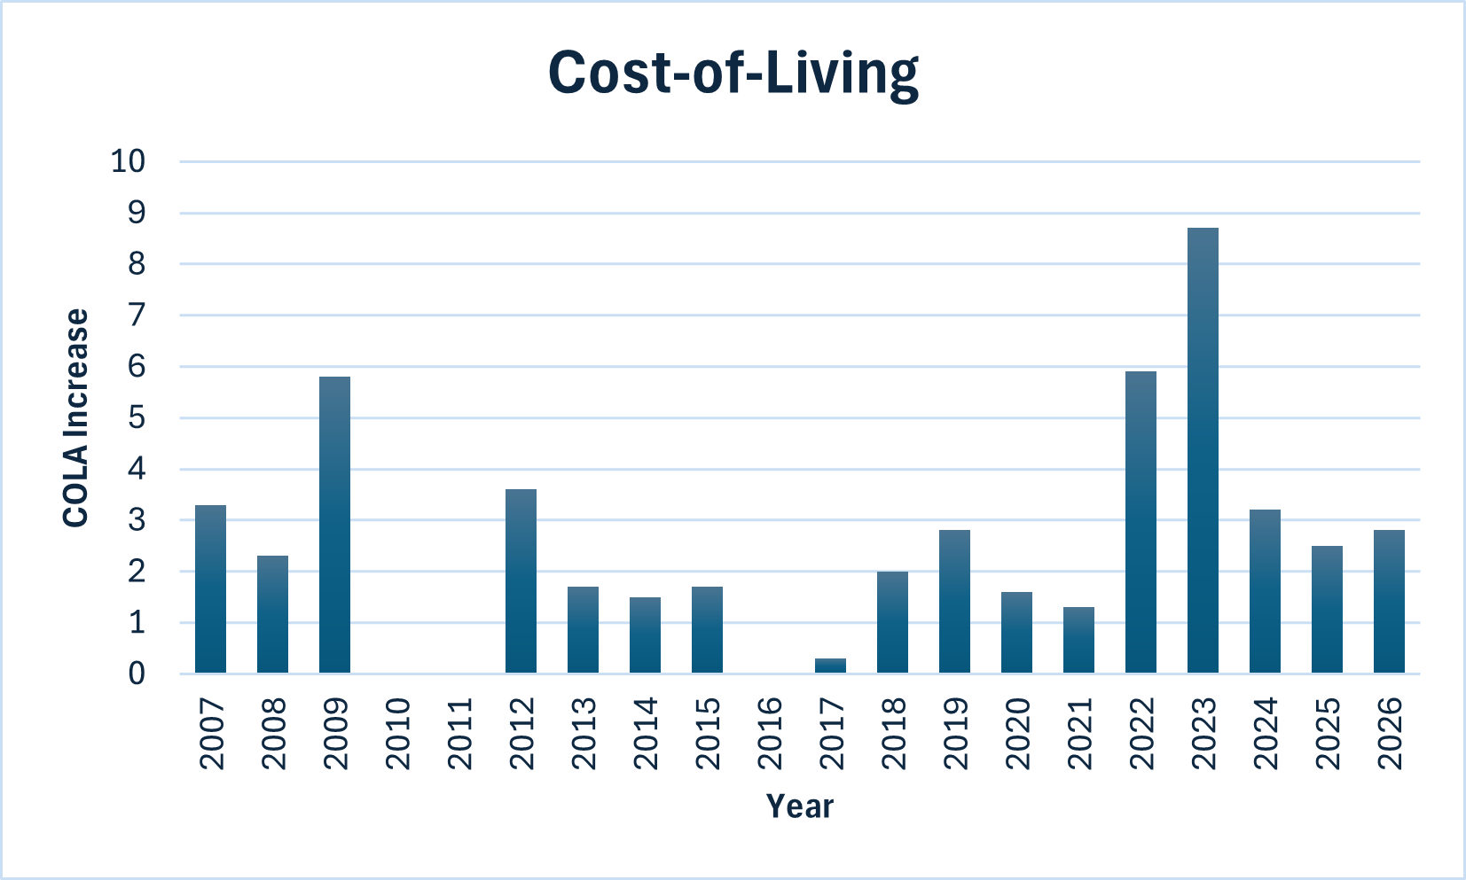
Social Security Cost-of-Living
Average 20 years = 2.55
Average 10 years = 3.11
No COLA 2010, 11, 16
AMACFOUNDATION.ORG | 888.750.2622 | SSADVISOR@AMACFOUNDATION.ORG
Notes:
This chart shows a 20 year history of COLA. Average for the last 20 years 2.5% and for the last 10 is 3.1%. The big change in that was coming out of COVID, we had high inflation, the increase was just over 8%. That's not normal. As I said, it can be zero as you can see happened in 2010, 2011 and 2016, but not negative.
When you apply for your benefits, the benefit will increase annually if there is a COLA increase.

Slide 7
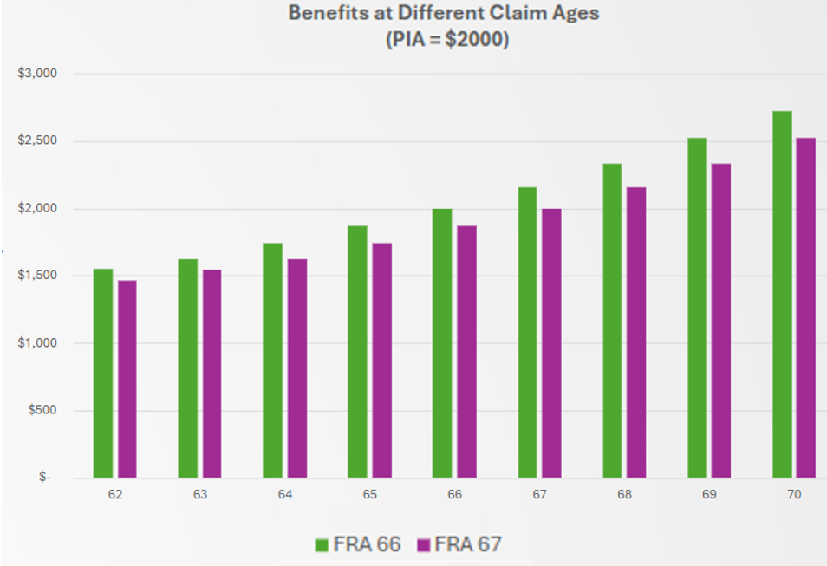
RETIREMENT BENEFITS
Collect Early??
Or Wait??
The longer you wait, the more you get each month
Claim at 62-- reduce your FRA benefit by 25 – 30% for life
Claim at FRA—receive full benefit
Wait until 70 - receive benefit 76% higher than at 62, 24% higher than than at 67
AMACFOUNDATION.ORG | 888.750.2622 | SSADVISOR@AMACFOUNDATION.ORG
Notes:
Collect early or wait?
When should I file? We get asked this question a lot. Our answer is, it depends.
The longer you wait, the higher your benefit. You can start as early as age 62. If your FRA is 67 and you start at 62, you will get about 70% of your FRA benefit. If you wait until your FRA you will get 100% of your benefit.
Or, if you wait until after your FRA, you will earn Delayed Retirement Credits (DRC) which increases the FRA amount by about 8% per year. So if your FRA is 67 and you wait until 70 you will get about 24% more in your monthly benefit.
Some things to consider when deciding: your health, income and expenses, family longevity, impact of taxes, are you going to continue to work, and are other members of your family eligible for benefits on your record. If you continue to work there is an Annual Earnings Test which I will talk about next. If other members of your family are eligible on your record, it might make sense to file early. Deb will be talking about these options.
Maybe a rule of thumb: If you need the money, you have poor health, take it early.
If you have a history of family longevity and really don't need the benefit right now, wait and let it grow.
What NOT to consider:
Solvency of Social Security – SS is not going bankrupt, right now it is fiscally solvent through at least 2032, even if congress does nothing as long as people continue to work and pay FICA taxes, the benefits do not stop; however, they will be reduced across the board.
Laws changing and negatively impacting you. Depending on your age.... Most people we talk to are 55 or older. When a law changes, such as raising the Full Retirement Age, SS has grandfathered people in that are 55 and older.
Politics. Whatever side is president, they cannot make changes – it has to be passed by congress and congress and voters want to protect seniors.

Slide 8

To Work or Not to Work??
Consider your future working plans when deciding
the month to start your benefits!!
Be Aware:
Earnings Limitations
  Below FRA—SSA retains $1 for every $2 earned above the limit
  Year of FRA —SSA retains $1 for every $3 earned above the limit
    Only earnings prior to FRA month count towards the limit
Tax Consequence
  May increase amount of SS check that is taxable on April 15
AMACFOUNDATION.ORG | 888.750.2622 | SSADVISOR@AMACFOUNDATION.ORG
Notes:
To Work or not to work?
Here is what I have mentioned earlier – to Work or Not to Work. If you are not at your FRA, collecting benefits and still working, there is an Annual Earnings Test. This is a maximum you can earn without penalty. In 2026 the maximum will be $24,480 in gross wages and net earnings from self-employment; things like pensions and annuities do not count towards this limit.
If you exceed the annual limit, SSA will withhold $1 for every $2 from your benefits you are over from your benefit.
Once you attain your FRA, the AET goes away. That is why your FRA and AET are really important to understand.
In the year you attain your FRA, the rules are different. For those who attain their FRA in 2026, the annual earnings limit is $65,160 in gross wages and net earnings from self-employment. If you exceed the limit SSA will withhold $1 for every $3 in your benefits you are over the limit. Only earnings in months prior to your FRA are counted towards the annual limit.
We get asked, if I do have benefits withheld, will I ever get them back. The answer is maybe. If there are months you are in work-suspense because you earned over the limit, when you attain your FRA, your benefits will be adjusted upward to give you credit for all months that you were suspended (did not receive a full benefit). This is known as an Adjustment of the Reduction Factor (ARF) and is a percentage based on the number of checks suspended.
And now I will turn it over to Deb to answer the rest of the 10 questions.

Slide 9
6. Is there a potential Social Security benefit payable to my spouse?
Status at Application | Still Married
Marriage Length | 1 year
Maximum Benefit | 50% of PIA of worker providing benefit
Reductions | Collecting prior to FRA Continued Employment (earnings test) Family Maximum
Example: | FRA 66, Collect at 62—receive 35% of PIA of worker providing benefit
AMACFOUNDATION.ORG | 888.750.2622 | SSADVISOR@AMACFOUNDATION.ORG
Notes:
Is there a potential SS benefit payable to my spouse?
Yes, IF.
To qualify for spousal benefit the lower earner's FRA retirement benefit must be less than half of the higher earner's FRA retirement benefit. If the lower earner's FRA retirement benefit exceeds half of the higher earner's FRA retirement benefits no spousal benefits are payable.
Two circumstances affect how the spousal benefit is paid.
First, is the spouse who is not eligible for their own benefit- either because they do not work outside the home or they do not have enough work credits.
This spouse receives a half of the higher earner's FRA retirement benefit amount
Second is the spouse who is eligible for their own benefit on their own work record.
This spouse must first claim their own retirement benefit. Then the difference needed to bring their total payment up to equal half the higher earner's FRA retirement benefit amount is added to their own retirement benefit amount.
Three other conditions must exist:
The marriage must be at least one year in length.
The higher earner must be receiving their retirement benefit.
Eligible spouse must be at least 62 years of age. If they are caring for a dependent child or disabled beneficiary, they can collect at any age.
Documents You’ll Need: Show original or certified copy of marriage license. Do not surrender the original.
Reductions apply when claiming benefit prior to FRA.
A point of interest is earnings limits apply until full retirement age.

Slide 10
7. How might other pensions impact my Social Security benefit?
WEP GPO
AMACFOUNDATION.ORG | 888.750.2622 | SSADVISOR@AMACFOUNDATION.ORG
Notes:
7. How might other pensions impact my SS benefit?
With the repeal of WEP and GPO in the Social Security Fairness Act of 2024, non-covered pensions no longer impact benefits.
Income from other pension sources also have no impact on your benefit amount.
You must have earned 40 quarter credits to qualify for a Social Security retirement benefit.
Points of Interest:
If your Social Security benefits increase due to elimination of WEP and GPO, there may be additional federal income taxes due.

Slide 11
8a. Are Social Security survivor benefits payable to SPOUSES and children?
Status at Application | Not Remarried Remarriage at 60 or later Disabled at 50 (remarriage also permitted at 50 )
Marriage Length | 9 months
Maximum Benefit | 100% of DECEASED SPOUSE benefit at time of death
Reductions | Survivor collecting benefit prior to full retirement age. Continued employment (earnings test)
AMACFOUNDATION.ORG | 888.750.2622 | SSADVISOR@AMACFOUNDATION.ORG
Notes:
8a. Are SS survivor benefits payable to Spouses and children?
Yes. Let's look at surviving spouses first.
For marriages with length of at least 9 months--
Surviving spouses are eligible as early as age 60 (or age 50 if disabled) (or any age if caring for dependent child) provided they do not remarry prior to age 60 (or age 50 if disabled).
Payment amount ranges from 71.5 to 100% of the deceased’s payment at time of death. This is affected by:
when surviving spouse claims the benefit in relation to special widow(ers) full retirement age,
if deceased was receiving benefits at time of death,
or if deceased started receiving benefits prior to their full retirement age,
or if deceased was not receiving benefits at time of death
A point of interest is earnings limits apply until full retirement age.

Slide 12
8b. Are Social Security survivor benefits payable to spouses and CHILDREN?
Status at Application | Under 18 years of age 18-19 years of age if fulltime student in high school Any age if disabled prior to 22 years of age
Maximum Benefit | 75% of deceased parent's benefit at full retirement age
Reductions | Family Maximum
AMACFOUNDATION.ORG | 888.750.2622 | SSADVISOR@AMACFOUNDATION.ORG
Notes:
8b. Are SS survivor benefits payable to Spouses and children?
Yes.
Surviving children are eligible if they are:
Under 18 years of age
--or—18-19 years of age if enrolled full time in high school
Disabled dependents may be any age provided they are found to be 100% disabled prior to 22 years of age
Payment amount is 75% of deceased parent's full retirement age benefit
A point of interest is family maximum. This applies when more than 2 people receive benefits generated by one deceased person's record. The maximum is generally 150 to 175% of the deceased's full retirement age benefit. The maximum is distributed equally among all recipients.

Slide 13
9a. Can I claim Social Security benefits earned by my ex-spouse? Ex-Spouse Living
Status at Application | Not remarried
Marriage Length | 10 years
Maximum Benefit | 50% of PIA of worker providing benefit
Reductions | Collecting prior to FRA Continued Employment (earnings test)
Example: | FRA 66, Collect at 62—receive 35% of PIA of worker providing benefit
AMACFOUNDATION.ORG | 888.750.2622 | SSADVISOR@AMACFOUNDATION.ORG
Notes:
9a. Can I claim SS benefits earned by my ex-spouse, if they are still living?
Yes.
There are different guidelines if your ex-spouse is living or has passed.
Let's look at living ex-spouse first.
Certain requirements apply:
Duration of the marriage had to be at least 10 years
You both must be at least 62 years of age
You cannot be remarried
Your ex-spouse must be collecting their own benefit (unless divorced at least 2 years)
Points of Interest:
Unlike spousal benefit—there is no provision for receiving benefit if less than 62 years of age with child(ren) in care
Your benefit as an ex-spouse has no impact on current benefits paid to worker or their current spouse
Reminder- your FRA retirement benefit must be less than half your ex- spouse's FRA retirement benefit to qualify for this benefit
And earnings limits apply until full retirement age

Slide 14
9b. Can I claim Social Security benefits earned by my ex-spouse? Ex-Spouse Deceased
Status at Application | Not Remarried Remarriage at 60 or later Disabled at 50 (remarriage also permitted at 50 )
Marriage Length | 10 years
Maximum Benefit | 100% of DECEASED SPOUSE benefit at time of death
Reductions | Survivor collecting benefit prior to Widow(er) FRA Continued employment (earnings test)
AMACFOUNDATION.ORG | 888.750.2622 | SSADVISOR@AMACFOUNDATION.ORG
Notes:
9b. Can I claim SS benefits earned by my ex-spouse if they are deceased?
Here are the differences if ex-spouse is deceased.
Remarriage is permitted if it occurs no sooner than 60 years of age (or no sooner than 50 years of age if disabled)
Benefit amount is based on benefit amount ex-spouse received at passing
Widow(er) FRA replaces retirement FRA for receiving 100% of the benefit

Slide 15
10. Can I undo a Social Security benefit claiming decision?--Withdraw Application
When | No later than 12 months after benefit payments begin
How Often | One time opportunity
Impact on Benefits Received | All recipients must repay benefits received
AMACFOUNDATION.ORG | 888.750.2622 | SSADVISOR@AMACFOUNDATION.ORG
Notes:
Final question #10 – Can I undo a SS benefit claiming decision?
Yes.
You may withdraw your application.
This is a one-time opportunity to cancel your application.
The opportunity expires 12 months after your benefit approval date.
All benefits received by all recipients on worker's record must be repaid.
You must submit new application when ready to start collecting.

Slide 16
Contact Us
Need to Speak to a Social Security Advisor?
Phone | 888-750-2622
Email | ssadvisor@amacfoundation.org
Website | www.amacfoundation.org
Additional Resources:
 | www.socialsecurityreport.org
 | www.medicarereport.org
Disclaimer: This webinar is intended for information purposes only and does not represent legal or financial guidance. It presents the opinions and interpretations of the AMAC Foundation’s staff, trained and accredited by the National Social Security Association (NSSA). NSSA and the AMAC Foundation and its staff are not affiliated with or endorsed by the Social Security Administration or any other governmental entity. To submit a question, visit our website (amacfoundation.org/programs/social-security-advisory) or email us at ssadvisor@amacfoundation.org.
Notes:
Now Mark will answer any questions that have been put in the chat. If you did not have a question in the chat, but have questions for an advisor, you may call AMAC
Monday thru Friday, 9:00am – 5:00pm Eastern Standard Time, or send us an email at ssadvisor@amacfoundation.org. The information is on the screen.
Leave this slide up while Mark answers questions.

Slide 17
Thank you for joining us!
AMACFOUNDATION.ORG | 888.750.2622 | SSADVISOR@AMACFOUNDATION.ORG

