Slide 1


Social Security Update - 2022
Presented by

Slide 2


The Growing AMAC Family
www.AMAC.us
www.AMACAction.org
www.AMACFoundation.org

Slide 3

The AMAC Foundation Mission
To help protect and ensure the financial security, health, and social lives of current and future mature Americans, and to help Americans navigate the bewildering array of decisions they need to make.

Slide 4
What the AMAC Foundation Does
Public Seminars on Topics Vital to Seniors
Publications on Matters Affecting Seniors
Dedicated Social Security and Medicare informational websites
  www.SocialSecurityReport.org
  www.MedicareReport.org
Coordination of AMAC Veterans Outreach Programs
Operation of our Accredited Social Security Advisory Program
Specialized Social Security “Concierge Services” for Private Corporations

Slide 5
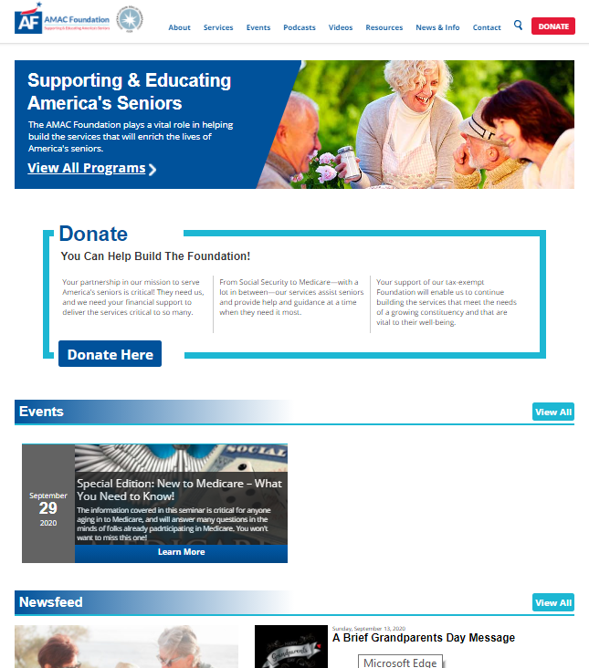
Our Primary Website (www.AmacFoundation.org)
Contents:
Foundation overview
Services we offer
Veterans Resources
Upcoming events
Audios
Videos
Resources
News & Interesting Information

Slide 6
Social Security Advisory Service 2016 - 2021

Slide 7
Social Security Advisory Service
Inception-to-date Activity Profile
  Launched January 2016
  Currently have seven (7) accredited advisors
  Monthly avg. = 550+
Highest Month – Feb 2021 (718)
Highest Quarter – 1Q2021 (1,825)
Avg. per Quarter – 1,665

Slide 8
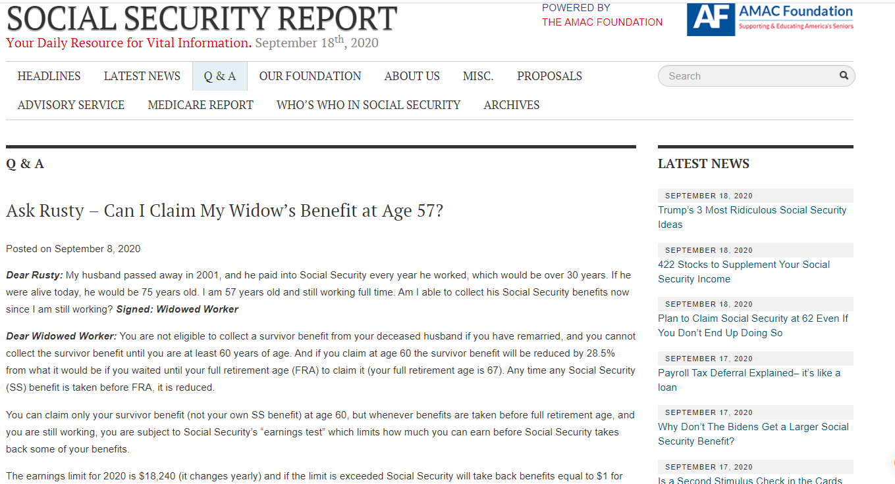

Social Security Advisory Service
Our “Ask Rusty” Series
  Launched in Early 2017
  Issued Weekly to 7000+ Media Outlets
  Have Now Published Hundreds of Editions
  Posted on Social Security Report Site
  Now Offering Audio Podcasts
  Compendium Published in Early 2019
  Second Compendium Published 9/2020

Slide 9
Social Security Advisory Service – New Services
Social Security Concierge Program
  Developed in 2021
  Provided on-site
  Major components:
    SS overview
    Customization for specific company needs
    Foundation-generated reference materials
    On-site, private counseling sessions
  Piloted at SECO in 2021
  First client just completed
Social Security Instant Academy
  Dev eloped in 2022
  1- to 2-minute audio clips on Social Security fundamentals
  Launched in February on Foundation Facebook page
  To repeat at bi-weekly interval
  Will be stored on Foundation website “Audio” page w/keyword searchability

Slide 10
You’ve Got Questions? We’ve Got Answers!
Here’s what we plan to cover today …
What’s New for 2022
The Basics (Eligibility, Calculation of benefits, Retirement Age)
When to file (Early, FRA, DRCs, Breaking Even)
Taxation of Benefits
Disability Basics (Eligibility, Working while on Disability, Transition to FRA)
Spousal Benefits (Married Couples, Divorced Spouses)
Surviving Spouse Benefits (Married Spouses and Ex-spouses)
Working after filing (The Earnings Test)
Cost of Living Adjustments (COLA)
Windfall Elimination Provision/Government Pension Offset (Who’s affected, Impact on Benefits)
Medicare Basics

Slide 11
Changes for 2022
2022 Cost of Living Increase - 5.9%
The National Average Wage Index determines
the following increases (or decreases)
 | 2021 | 2022
Maximum Taxable Earnings | $142,800 | $147,000
Maximum SS Benefit @ 70 | $3,895 | $4,124
Quarter of Coverage | $1,470 | $1,510
Earnings Test – under FRA | $18,960/year ($1,580/month) | $19,560/year ($1,630/month)
Earnings Test – Year of FRA | $50,520/year ($4,210/month) | $51,960/year ($4,330/month)

Slide 12
Who Can Collect Social Security?
Retirees (workers at least 62 years old)
Must have at least 40 quarter credits (10 years) of work to be eligible
“Quarter credit” = $1,510 per quarter. $6,040/year = 4 quarter credits
Spouses of Living Retirees (at least 62)
Current Spouses
Ex-Spouses (if married 10 years)
Survivors of Deceased Retirees (at least 60 (50 if disabled))
Current, and ex-Spouses
Dependent Children under 18 (or 19 if still in high school)
Dependent Parents
Disabled
Disabled workers with enough quarter credits (varies with age when disabled)
Disabled adult child if disability started before 22.

Slide 13
How Is My Benefit Calculated?
Social Security has your lifetime earnings record (from IRS)
Annual earnings are adjusted for inflation
35 highest earning years (to annual max) are selected and totaled
Divided by 420 to arrive at your “Average Indexed Monthly Earnings” (AIME)
AIME is then divided into three segments used to compute your benefit at your Full Retirement Age (also known as your Primary Insurance Amount or “PIA”)
Here is the benefit computation for someone who becomes
eligible for SS in 2021, with an AIME of $6,200
Segments | Applied to | Multiplier | PIA Portion
First | $0 to $1024 of AIME | 90% | $921.60
Second | $1025 to $6172 of AIME | 32% | $1,647.36
Third | Over $6172 | 15% | $4.20
Calculated Primary Insurance Amount (PIA) |  |  | $2,573
≈40% of AIME

Slide 14
Cost-of-Living-Adjustment (COLA)
How COLA is Determined
  Consumer Price Index for Urban Wage Earners and Clerical Workers, or “CPI-W”
  Average change over time in the spending patterns of workers employed in clerical or wage-paying jobs
  Based on workers who have been employed for at least 70 percent of the year.
  CPI-W is measured monthly, but only the third quarter counts
    CPI-W for July-September of current year is compared to previous year
    If higher, the result is next year’s COLA
    If lower, COLA set at 0%

Slide 15
Cost-of-Living-Adjustment
2022 COLA – 5.9%
Social Security COLA History – 2000 - 2022
2022 COLA Reflects Past (2021) Higher Prices Already Paid

Slide 16
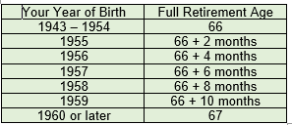
What Is My Full Retirement Age (FRA)?
Your “full retirement age” is when you can collect 100% of what you’ve earned by working over your lifetime
Your FRA depends on when you were born:
Before 1938: 65
1938 to 1942: 65 + 2 months each year
“Full Retirement Age” for people retiring today is between 66 and 67
Raising the FRA in the future is possible, but wouldn’t affect today’s retirees

Slide 17
At What Age Should I Claim Benefits?
Only About 10%
Wait Past FRA
There is no one “best age” to retire; everyone is different
Answer to the question “When should I apply?” is “It depends”
It depends on your health & how long you expect to live
It depends on your financial situation – Do you need the money now?
It depends on your marital status & the concern for survivors’ benefits
BUT, don’t apply because you think Social Security is going bankrupt – it’s not !!

Slide 18
What if I retire early, or later?
Starting at 62 will reduce your retirement benefit by 25 – 30% for life
The longer you wait, the more you get each month
Starting after your FRA can increase your retirement benefit by up to 32%

Slide 19
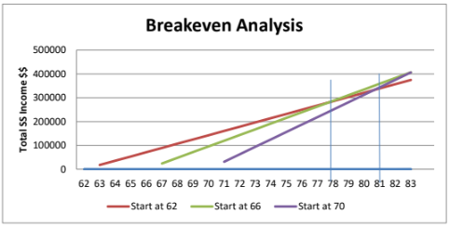
When Do I “Break Even”?
There’s a mathematical point at which the amount you receive if you claim later equals the amount you would have received if you had started early, usually between ages 78 and 83.
FRA v. 70
62 v. 70
62 v. FRA

Slide 20
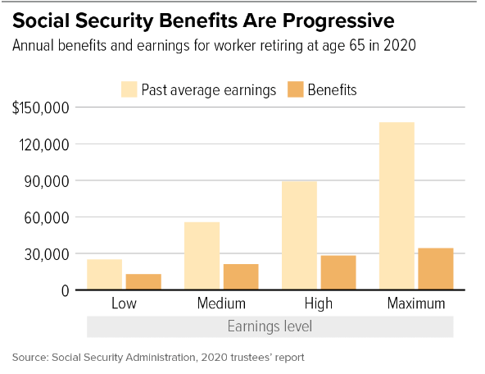
Social Security Benefits – “By the Numbers”
2022 Maximum Benefit Amounts
  At FRA: $3,345
  At age 70: $4,124
Average Benefits
  Retiree: $1,657
  Retired Couple: $2,753
50% of couples and 70% of singles rely on Social Security for 50% of their income
21% of couples and 45% of singles rely on Social Security for 90% of their income
Average preretirement annual income
compared to
Average annual SS benefits
SS replaces 20 – 40% of preretirement income

Slide 21
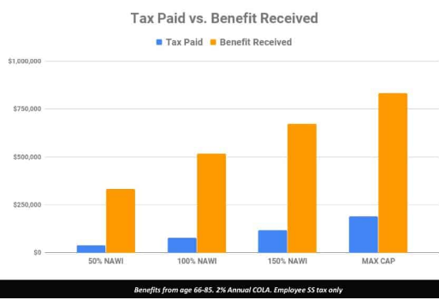
What About My “ROI”?
Dispelling a Myth
Will I Ever Get Back What I put into Social Security?
Time to Breakeven:
34 months
43 months
50 months
63 months
Assumes 2% annual COLA increase

Slide 22
Working and Collecting Social Security
Continuing to work can increase your benefit by replacing early-career years with no/low earnings, but……
If you continue to work after starting benefits early (before FRA), there is a limit to how much you can earn without affecting your benefits (2022 limit = $19,560/year or $1,630/month) (Limit is higher in year you reach FRA)
If you retire mid-year and continue working, you may be affected by the monthly limit
If you exceed annual earnings limit, SS will withhold $1 for every $2 over the limit (“Penalty” is less in year you reach FRA)
After you reach your FRA there is no earnings limit.
Anything withheld from your benefits, may be eventually returned:
When you reach your FRA, your benefit will be recomputed to give you credit for any months of withheld benefits (and your benefit will go up). You’ll get that new higher benefit for the rest of your life.
Consider your future working plans while deciding when to apply for Social Security!!

Slide 23
Working and Social Security
Special Rules for the Year You Reach FRA:
  Between January 1 and the month you reach FRA, you can earn up to $51,960 (2022 limit) without reduction
  If you exceed that limit, $1 for every $3 earned in excess will be withheld
  If this is your first year of taking your benefits and you continue to work, you may be subject to the monthly limit of $4,330 until you reach FRA.
  The limit disappears in the month you reach FRA and there is no longer an earnings limit beyond that point

Slide 24
Are Social Security Benefits Taxable?
Yes, if:
“Modified Adjusted Gross Income” (MAGI) Levels are exceeded
  Filing Single = $25,000 and $34,000
  Married Filing Jointly = $32,000 and $44,000
If first level exceeded, up to 50% of SS benefits are taxable
If second level exceeded, up to 85% of SS benefits are taxable
Benefits not taxable if first “MAGI”
threshold is not reached.
Note: Tax withholding from Social Security benefits is optional

Slide 25
Some Basics on Disability (SSDI)
SSDI is available to those who:
Have a physical or mental condition that prevents them from engaging in "substantial gainful activity" ("SGA")
  The condition is expected to last at least 12 months or result in death
Are under their Full Retirement Age & have sufficient Social Security Work Credits
Apply for SSDI as soon as you become disabled
The determination process can take 3 to 5 months (can be longer)
Compassionate Allowances are available (over 200, including certain types of cancers, ALS - Lou Gehrig's Disease, et al.)
If approved, there is a 5-month waiting period (payments are made in the sixth month after your date of disability)
There is an option for Spousal Benefits
Recipient can be eligible for spousal benefit as early as age 62
  Not subject to deemed filing, may wait to FRA to receive maximum benefit.
Spouse must be collecting benefits

Slide 26
Spouses, ex-spouses and survivors
Spouses & Ex-spouses
Spouses and ex-spouses collecting at 62 with FRA of 66 will receive about 35% of worker’s PIA; up to 50% at their FRA (reduction for FRA of 67 even greater)
Ex-spouses must have been married to worker for at least 10 years and not remarried
No “spousal boost” if benefit on own work record is greater
Survivors
Surviving spouses at FRA get 100% of worker’s benefit if married 9 months or more
Surviving ex-spouses get 100% of worker’s benefit if married 10 years or more
Both can collect reduced benefits at 60 (50 if disabled); can collect earlier if caring for minor child of deceased
Dependent minor children and dependent parents can also get benefits
Family maximum may apply

Slide 27
Spouses, ex-spouses and survivors
For spousal benefits
https://www.ssa.gov/oact/quickcalc/spouse.html

Slide 28
Sunsetting the “Restricted Application”
“Restricted Application for Spousal Benefits Only”
This strategy is no longer available for anyone born January 2, 1954, or later.
The last age group eligible to use this strategy turned 66 on January 1st, 2020
If you have not claimed your benefits yet, and were born before January 2nd, 1954, and your spouse has taken their benefits, you can file a restricted application.
Ex-spouses can file a restricted application if their ex-spouse is eligible to receive benefits and they meet all the other requirements.
Divorced spouses can file on each other.

Slide 29
Maximum Taxable Earnings in 2022
$147,000
AKA the “wage base” or “SS Payroll Tax Cap” – the maximum earnings on which you pay a 6.2% SS FICA tax (Note: Medicare 1.45% FICA tax doesn’t stop)
2022 wage base = $147,000 (up from 2021 wage base of $142,800)
Determined by changes to the National Average Wage Index (NAWI), but the formula will make your eyes glaze over
Changes only if COLA is given, and only if more than previous year’s base

Slide 30
Windfall Elimination Provision (WEP)
Applies to SS beneficiaries with “non-covered pension” earned without contributing to Social Security (SLG employees in 26 states, foreign pensions, etc.)
Earnings from this work not in SS records; beneficiary looks like a low-income worker & would get higher benefit
WEP uses a different benefit formula to equalize (reduce) SS benefit
Earnings from years of Social Security-covered work can offset the WEP reduction
WEP applies to retirement benefits, not spousal or survivor benefits, but spouse benefits based upon WEP-reduced PIA
Avoid the WEP reduction by:
  Forfeiting non-covered pension, or
  Withdrawing all contributions before start of non-covered pension

Slide 31
Government Pension Offset (GPO)
Applies to spouses & survivors who receive a pension from government work that was not covered by Social Security
  Applies to spouses, divorced spouses, surviving spouses, surviving divorced spouses, and deemed spouses
  GPO results in Social Security spousal benefit reduction of $2 reduction for every $3 (or .667%) of non-covered pension
To avoid the GPO reduction:
  For at least five years before retiring, work in a position where you are contributing to both Social Security and the same pension plan.

Slide 32
Medicare

Slide 33
Medicare Basics
You don’t need to take Social Security when you enroll in Medicare!
The Parts of Medicare:
Part A – Coverage for in-patient hospitalization services
Part B – Outpatient services (doctors, medical tests, etc.)
Part D – Prescription Drug coverage from private insurers
Part C – Medicare Advantage (private coverage replacing Parts A and B
(and sometimes Part D)
Part A is free to those eligible for SS
Part B standard 2022 premium is $170.10
Part D premiums vary by provider & plan selected
Part C may, or may not, be additional cost (over Part B)

Slide 34
Medicare Doesn’t Cover Everything
Medicare doesn’t cover:
Prescription drugs
Eyeglasses and exams to get glasses
Hearing aids and exams to get aids
Dental care or dentures
Long term (custodial) care
Acupuncture
Routine foot care
Medicare pays 80% of covered services; 20% is co-pay
Medicare Part A and B both have a deductible:
Part A 2022 deductible = $1,556
Part B 2022 deductible = $233
What are “Medigap” Supplemental plans and Medicare Advantage plans?

Slide 35
Do you need to take Medicare at 65?
You must have Part A to collect Social Security after age 65
Part B isn’t mandatory because there is a premium …. but ….
  you’ll pay a lifetime late enrollment penalty if you enroll outside your Initial Enrollment Period (65), or Special Enrollment Period
You can defer enrolling in Medicare if you have “creditable” healthcare coverage
from your employer

Slide 36
Some other Medicare Considerations:
What is “creditable” healthcare coverage?
  VA healthcare isn’t (but VA prescription drug coverage is)
  Retiree healthcare plans aren’t creditable
  Faith-based and other health-sharing plans aren’t “creditable”
The “Late Enrollment Penalty” (for Part B and Part D)
“IRMAA” (Income Related Monthly Adjustment Amount)
Medicare and the “The “Hold Harmless” provision

Slide 37
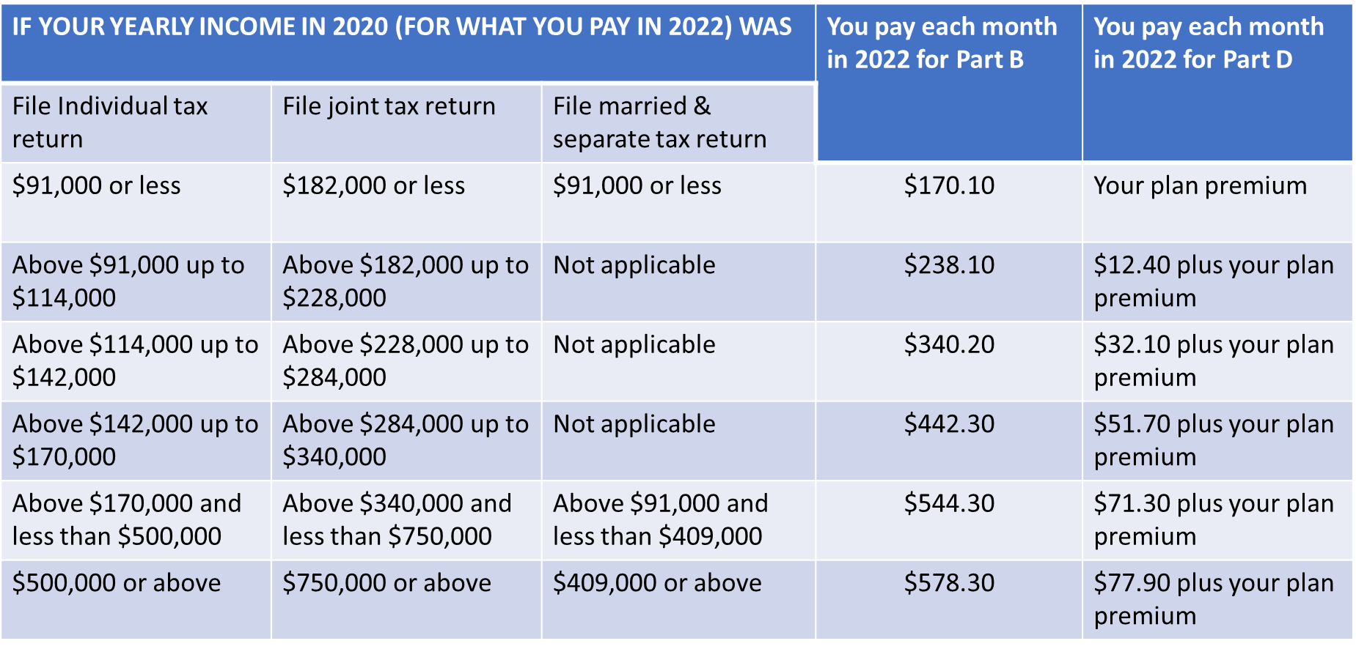
Some other Medicare Considerations:

Slide 38

Some other Medicare Considerations:
Life- Changing Event | Use this Category if….
Marriage | You entered into a legal marriage
Divorce/Annulment | Your legal marriage ended, and you will not file a joint return with your spouse for the year
Death of your Spouse | Your spouse died
Work Stoppage or Reduction | You or your spouse stopped working or reduced the hours that you work
Loss of Income-Producing Property | You or your spouse experienced a loss of income-producing property that was not at your direction. This includes loss of real property in declared disaster area, destruction of livestock or crops due to natural disaster or disease, or loss of property due to arson, or loss of investment property due to fraud or theft
Loss of Pension Income | You or your spouse experience a scheduled cessation, termination or reorganization of an employer’s pension plan
Employer Settlement Payment | You or your spouse receive a settlement from an employer or former employer because of the employer’s bankruptcy or reorganization

Slide 39
  The Impending Social Security Solvency Crisis
What’s the problem?
As of 2021, Social Security is in a deficit situation
By 2034, reserves will be fully depleted, benefits would be cut
How did we get to this point?
Life expectancies increasing
Less workers paying into Social Security
Birth rates significantly lower than previous generations
Interest rates at historical lows
What can (must) be done?
Legislative corrections/Congressional action
Typically, increase tax revenue and/or curtail benefits
AMAC Social Security Guarantee
Can achieve solvency without raising taxes
Ensures benefits for lower earners, slight reductions for higher earners
Provides vehicle for independent savings

Slide 40
Thank you for Joining Us!
Watch the Foundation’s “Events” page for future sessions
  www.AmacFoundation.org/Events
Our Social Security Advisory Service is available free-to-the public anytime
  Visit www.AmacFoundation.org/Services for direction
  Call 1.888.750.2622, or email questions to SSAdvisor@amacfoundation.org
To stay current on what’s happening in Social Security and Medicare, visit our two information-packed websites:
  www.SocialSecurityReport.org
  www.MedicareReport.org

Slide 41


