Slide 1
AMAC Foundation – 2017 Seminar Series
AMAC Foundation, Inc.
“Supporting and Education America’s Seniors”
www.AmacFoundation.org

Slide 2
AMAC Foundation – 2017 Seminar Series
Today’s Workshop:
“Life After Cable—Entertainment Alternatives”
OR
“Cutting the Cord”

Slide 3
Cutting the Cord
Alternative Solutions to Cable Television

Slide 4
Topics
Streaming Services
Major Streaming Services
Netflix, Hulu, Amazon Video, and Sling TV.
Streaming Devices
Google Chromecast, Amazon Fire TV, Roku Devices, Sling box, and Apple TV.

Slide 5
Netflix

Slide 6
Netflix Summary
Pro: Competitive price point. Netflix plans range from $7.99-$11.99. | Pro: No hassle cancellation, no contracts are involved and you can back out at any time. | Pro: High Quality selection of Original Programming. (House of Cards, Orange Is the New Black, Stranger Things, Marvel Shows, The Ranch) | Pro: Easily accessible through a wide range of devices. (Smart Phones, Apple TV, PCs, Smart Televisions, Streaming Devices, Tablets) | Pro: Able to watch on lower speed internet connections. Viewable almost anywhere.
Con: Newer TV shows and Movies are not available. Delay in content. (Game of Thrones, The Walking Dead) | Con: No channel surfing, you have to choose from available media. You can’t just choose AMC and see what's on. | Con: You will not find news related media on Netflix. (Fox, CNN, BBC) | Con: Licensing Agreements. Shows will come and go. On January 4th 2014 90 films and tv shows were removed. | Con: Hulu has around 10,000 titles Netflix has around 7,000 titles Amazon Prime Video has around 20,000 titles

Slide 7
Hulu

Slide 8
Hulu Summary
Pro: Competitive pricing. Showtime addon available for an additional $8.99 a month. No Hassle Cancellation. | Pro: Generally more up to date on tv shows, with new episodes released barely a day after. | Pro: Hulu originals. The Handmaid’s Tale, Dimension 404, The Path. | Pro: All major streaming devices and app stores have a Hulu app | Pro: Heavily focused on TV shows.
Con: Hulu will have the latest season for a TV show but not earlier ones. | Con: Limited movie selection compared to Amazon and Netflix | Con: Commercials unless you are willing to pay more just to get rid of them. | Con: Original content is not rated as highly or as numerous as Amazon or Netflix. | Con: Not always available on internet ready TV’s and Blu-ray players. Spotty record with HD content.

Slide 9
Hulu Live (Beta)
$39.99 a month
No installation appointments or equipment rentals
Record live TV with up to 50 hours on storage
Still have access to regular Hulu
Live games from major pro and college leagues, including NFL, NBA, MLB, NHL, and NCAA.
Games are subject to regional availability and blackouts. Rights restrictions prevent live streaming of NFL games on smartphones.

Slide 10
Hulu Live Channels

Slide 11
Amazon Prime Video

Slide 12
Amazon Prime Video
Prime (monthly)
Price was increased to $12.99 on 01/19/18

Slide 13
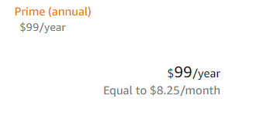
Amazon Prime Video

Slide 14
Amazon Prime Video Summary
Pro: Included with Amazon Prime membership. Benefits are numerous. Prime Music is included. | Pro: Amazon Prime Video has numerous channels you can add for an additional fee. (HBO, Showtime, Starz, Cinemax.) | Pro: HD content included in the plan. (Not included in base plan for Netflix) | Pros: Amazon Originals are high quality. The Man in the High Tower.
Con: Limited Content outside of the US. | Con: Not all content you see is included. They need to have a Prime banner. Other things are available to rent or buy. | Con: HD content is limited. | Con: More devices are Netflix ready.

Slide 15
Playstation Vue

Slide 16
Playstation Vue Channel List

Slide 17
Antenna TV
Minimum 60 mile antenna, 70 and above is much better
Anywhere between 36 and 42 channels
Some of those channels will be worship, Spanish, old time movie channels
Antenna needs to be facing South East and above the tree line
Check with your HOA

Slide 18
Sling TV
What is it?
A service that allows subscribers to watch live and on-demand TV channels on compatible devices; TVs, computers, and mobile devices. It is owned by Dish Network but operated separately.
Only available in the United States
Cheaper alternative to most TV services, only requires a good internet connection, and a compatible device to run the required app.
No contracts. Cancel anytime.
Think of it as Netflix but with live tv.

Slide 19
Sling Orange

Slide 20
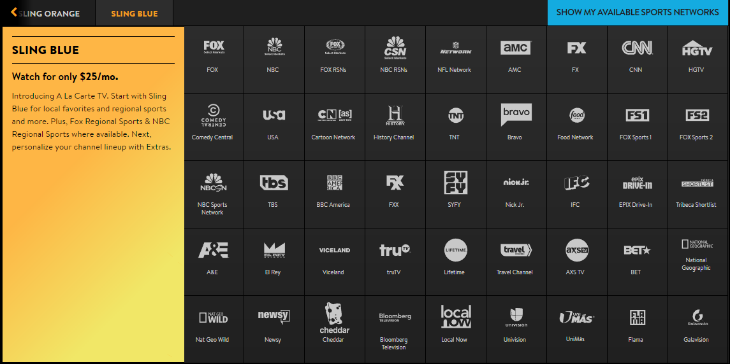
Sling Blue

Slide 21
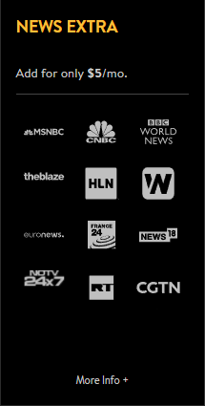
Sling Extras

Slide 22
Sling Box
What is it?
The Sling Box is an audio-video device that lets you watch and control your TV from any device in a process called placeshifting.
Controllable from a laptop, phone, tablet, or a television with the proper device.
SlingPlayer is available for the iPhone, android phones, computers, iPads, and Mac computers.
It is only usable by one person at a time. Someone at your house cannot watch something separately.
Slingbox M2 $99.99
Slingbox 500 $299.99
Slingbox 500 adds HDMI connectors

Slide 23
Google Chromecast
HDMI connection to your television.
Setup once and connects to your wifi.
Google Cast what you are watching on your device to your television.
$35 for regular
$69.99 for Ultra. (4k Ultra HD)

Slide 24
Apple TV
HDMI connection to television
Stream iTunes content, mirror capabilities of IOS devices
Has its own controller with voice search capabilities.
Numerous built in apps
Netflix
Youtube
Hulu
Twitter
$149.99

Slide 25
Roku

Slide 26
Amazon Fire TV
HDMI connection
Live TV streaming available from certain channels
HBO Now, NFL, NBC, Fox, BBC, amc, Cartoon Network, History Channel. Many more.
$89.99 comes with a remote with voice control.
Integrated with SlingTv, Netflix and Hulu apps also available.

