Slide 1

Social Security Update - 2021
Presented by

Slide 2


The Growing AMAC Family
www.AMAC.us
www.AMACAction.org
www.AMACFoundation.org

Slide 3

The AMAC Foundation Mission
To help protect and ensure the financial security, health, and social lives of current and future mature Americans, and to help Americans navigate the bewildering array of decisions they need to make.

Slide 4
What the AMAC Foundation Does
Public Seminars on Topics Vital to Seniors
Publications on Matters Affecting Seniors
Dedicated Social Security and Medicare informational websites
  www.SocialSecurityReport.org
  www.MedicareReport.org
Operation of an Accredited Social Security Advisory Program

Slide 5

Our Primary Website (www.AmacFoundation.org)
Contents:
Foundation overview
Services we offer
Veterans Resources
Upcoming events
Audios
Videos
Resources
News & Interesting Information

Slide 6
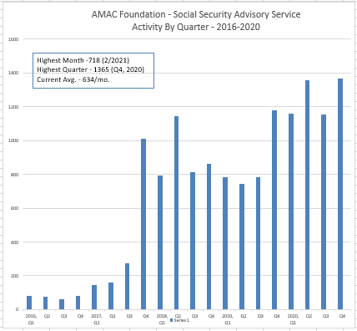
Social Security Advisory Service
  Launched January 2016
  Currently Have six Accredited Advisors
  Now Averaging 600+ Inquiries per Month

Slide 7
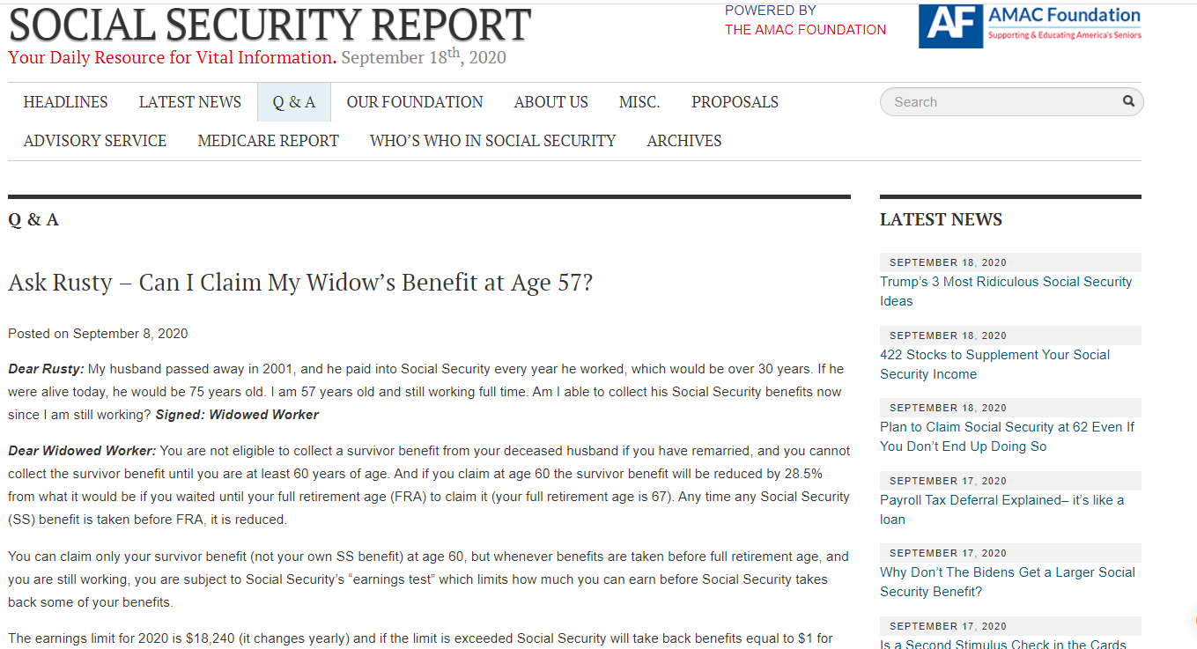
Social Security Advisory Service
Our “Ask Rusty” Series
  Launched in Early 2017
  Issued Weekly to 7000+ Media Outlets
  Have Now Published Hundreds of Editions
  Posted on Social Security Report Site
  Now Offering Audio Versions
  Compendium Published in Early 2019
  Second Compendium Published 9/2020

Slide 8
Social Security Questions…
We’ve Got Some Answers!
Here’s what we plan to cover today …
What’s New for 2021
The Basics (Eligibility, Calculation of benefits, Retirement Age)
When to file (Early, FRA, DRCs, Breaking Even)
Taxation of Benefits
Disability Basics (Eligibility, Working while on Disability, Transition to FRA)
Spousal Benefits (Married Couples, Divorced Spouses)
Surviving Spouse Benefits (Married Spouses and Ex-spouses)
Working after filing (The Earnings Test)
Cost of Living Adjustments (COLA)
Windfall Elimination Provision/Government Pension Offset (Who’s affected, Impact on Benefits)
Medicare and Social Security

Slide 9
What’s New in 2021
2021 Cost of Living Increase - 1.3%
The National Average Wage Index determines
the following increases (or decreases)
 | 2021 | 2020
Maximum Taxable Earnings | $142,800 | $137,700
Maximum SS Benefit FRA | $3,148 | $3,011
Quarter of Coverage | $1,470 | $1,410
Earnings Test – under FRA | $18,960/year ($1,580/month) | $18,240/year ($1,520/month)
Earnings Test – Year of FRA | $50,520/year ($4,210/month) | $48,600/year ($4,050/month)

Slide 10
Who can collect Social Security?
Retirees (workers at least 62 years old)
Must have at least 40 quarter credits (10 years) of work to be eligible
“Quarter credit” = $1,470 per quarter. $5,880/year = 4 quarter credits
Spouses of Living Retirees (at least 62)
Current Spouses
Ex-Spouses (if married 10 years)
Survivors of Deceased Retirees (at least 60 (50 if disabled))
Current, and ex-Spouses
Dependent Children under 18 (or 19 if still in high school)
Dependent Parents
Disabled
Disabled workers with enough quarter credits (varies with age when disabled)
Disabled adult child if disability started before 22.

Slide 11

Social Security has your lifetime earnings record (from IRS)
Annual earnings are adjusted for inflation
35 highest earning years (to annual max) are selected and totaled
Divided by 420 to arrive at your “Average Indexed Monthly Earnings” (AIME)
AIME is then divided into three segments used to compute your benefit at your Full Retirement Age (also known as your Primary Insurance Amount or “PIA”)
Here is the benefit computation for someone who becomes
eligible for SS in 2021, with an AIME of $6050
Segments | Applied to | Multiplier | PIA Portion
First | $0 to $996 of AIME | 90% | $896.40
Second | $996 to $6002 of AIME | 32% | $1601.92
Third | Over $6002 | 15% | $7.20
Calculated Primary Insurance Amount (PIA) |  |  | $2505

Slide 12

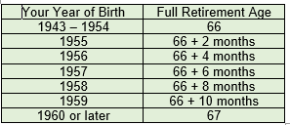
Your “full retirement age” is when you can collect 100% of what you’ve earned by working over your lifetime
Your FRA depends on when you were born:
Before 1938: 65
1938 to 1942: 65 + 2 months each year
“Full Retirement Age” for people retiring today is between 66 and 67
Raising the FRA in the future is possible, but wouldn’t affect today’s retirees

Slide 13

There is no one “best age” to retire; everyone is different
Answer to the question “When should I apply?” is “It depends”
It depends on your health & how long you expect to live
It depends on your financial situation – Do you need the money now?
It depends on your marital status & the concern for survivors’ benefits
BUT, don’t apply because you think Social Security is going bankrupt – it’s not !!

Slide 14

Starting at 62 will reduce your retirement benefit by 25 – 30% for life
The longer you wait, the more you get each month
Starting after your FRA can increase your retirement benefit by up to 32%

Slide 15

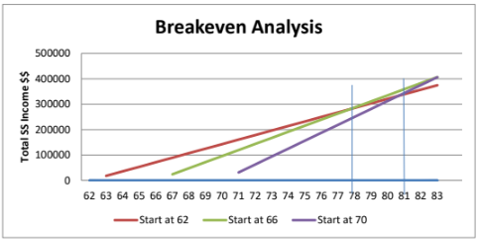
There’s a mathematical point at which the amount you receive if you claim later equals the amount you would have received if you had started early, usually between ages 78 and 83.
FRA v. 70
62 v. 70
62 v. FRA

Slide 16
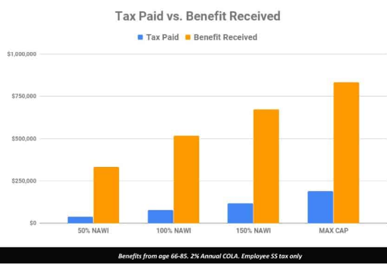
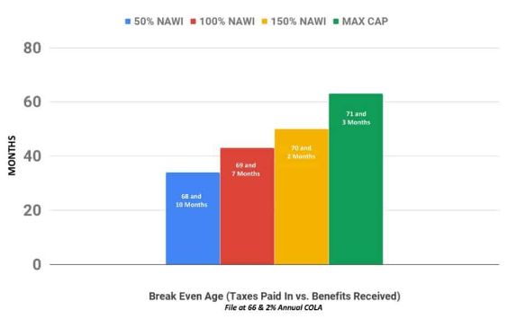
What About Your Social Security “ROI”?
Dispelling a Myth
Will I Ever Get Back What I put into Social Security?
Breakeven Age – Taxes Paid v. Benefits Received

Slide 17
Working and Social Security
Continuing to work can increase your benefit by replacing early-career years with no/low earnings, but……
If you continue to work after starting benefits early (before FRA), there is a limit to how much you can earn without affecting your benefits” (2021 limit = $18,960/year or $1,580/month)
If you exceed annual earnings limit, SS will withhold $1 for every $2 over the limit (after you reach your FRA there is no earnings limit) If you retire mid-year and continue working, you may be affected by the monthly limit.
Anything withheld from your benefits, may be eventually returned:
When you reach your FRA, your benefit will be recomputed to give you credit for any months of withheld benefits (and your benefit will go up). You’ll get that new benefit for the rest of your life.
Consider your future working plans while deciding when to apply for Social Security!!

Slide 18
Working and Social Security
Special Rules for the Year You Reach FRA:
  Between January 1 and the month you reach FRA, you can earn up to $50,520 (2021 limit) without reduction
  If you exceed that limit, $1 for every $3 earned in excess will be withheld
  If this is your first year of taking your benefits and you continue to work, you may be subject to the monthly limit of $4,210.
  The limit disappears in the month you reach FRA and there is no longer an earnings limit beyond that point

Slide 19
Are Social Security Benefits Taxable?
Yes, if:
“Modified” Income Levels are exceeded
  Filing Single = $25,000 and $34,000
  Married Filing Jointly = $32,000 and $44,000
If first level exceeded, up to 50% of SS benefits are taxable
If second level exceeded, up to 85% of SS benefits are taxable
Benefits not taxable if first modified income
threshold is not reached.
Note: Tax withholding on Social Security benefits is optional

Slide 20
Some Basics on Disability (SSDI)
SSDI is available to those who:
Have a physical or mental condition that prevents them from engaging in any "substantial gainful activity" ("SGA")
  The condition is expected to last at least 12 months or result in death
Are under their Full Retirement Age
Have sufficient Social Security Work Credits
Apply for SSDI as soon as you become disabled
The determination process can take 3 to 5 months (can be longer)
Compassionate Allowances are available (there are more than 200, including certain types of cancers, ALS - Lou Gehrig's Disease, et al.)
If approved, there is a 5-month waiting period (payments are made in the sixth month after your date of disability)
There is an option for Spousal Benefits
Recipient can be eligible for spousal benefit as early as age 62
  Not subject to deemed filing, may wait to FRA to receive maximum benefit.
Spouse must be collecting benefits

Slide 21
Spouses, ex-spouses and survivors
Spouses & Ex-spouses
Spouses and ex-spouses collecting at 62 with FRA of 66 will receive about 35% of worker’s PIA; up to 50% at their FRA (reduction for FRA of 67 even greater)
Ex-spouses must have been married to worker for at least 10 years and not remarried
No “spousal boost” if benefit on own work record is greater
Survivors
Surviving spouses at FRA get 100% of worker’s benefit if married 9 months or more
Surviving ex-spouses get 100% of worker’s benefit if married 10 years or more
Both can collect reduced benefits at 60 (50 if disabled); can collect earlier if caring for minor child of deceased
Dependent minor children and dependent parents can also get benefits
Family maximum may apply

Slide 22
Spouses, ex-spouses and survivors
For spousal benefits
https://www.ssa.gov/oact/quickcalc/spouse.html

Slide 23
The Ending of the Restricted Application for Spousal Benefits only
Spouses & Ex-spouses
This strategy is no longer available for anyone born January 2nd, 1954 or later.
The last age group eligible to use this strategy turned 66 on January 1st, 2020
If you have not claimed your benefits yet, and were born before January 2nd, 1954, and your spouse has taken their benefits, you can file a restricted application.
  Ex-spouses can file a restricted application as long as their ex-spouse is eligible to receive their benefits and they meet all the other requirements.
Divorced spouses are the only ones that can file on each other.

Slide 24
Cost-of-Living-Adjustment
How COLA is Determined
  Consumer Price Index for Urban Wage Earners and Clerical Workers, or CPI-W
  Average change over time in the spending patterns of workers employed in clerical or wage-paying jobs
  Based on workers who have been employed for at least 70 percent of the year.
  CPI-W is measured monthly, but only the third quarter counts
    CPI-W for July-September of current year is compared to previous year
    If higher, the result is next year’s COLA
    If lower, COLA set at 0%

Slide 25
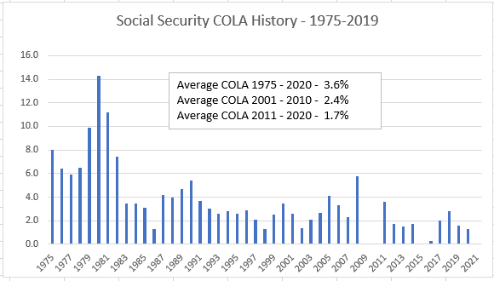
Cost-of-Living-Adjustment
2021 COLA – 1.3%

Slide 26
Maximum Taxable Earnings in 2021
$142,800
AKA the “wage base” or “SS Payroll Tax Cap” – the maximum earnings on which you pay a 6.2% SS FICA tax (Note: Medicare 1.45% FICA doesn’t stop)
2021 wage base = $142,800(up about 3.7% from 2020 wage base of $137,700)
Determined by Changes to the National Average Wage Index
  The formula will make your eyes glaze over
  1994 wage base times the ratio of previous year NAWI compared to 1992 NAWI
  Here’s how 2021 wage base was calculated:
    1994 wage base = $60,600
    1992 NAWI = 22,935.42
    2019 NAWI = 54.099.99
    $60,600 times 54,099.99 divided by 22,935.42 equals $142,943.07, which rounds to $142,800
  Changes only if COLA is given, and only if more than previous year’s base
Maximum SS payroll tax for 2021 is $8,853.60– up $316.20 over 2020

Slide 27
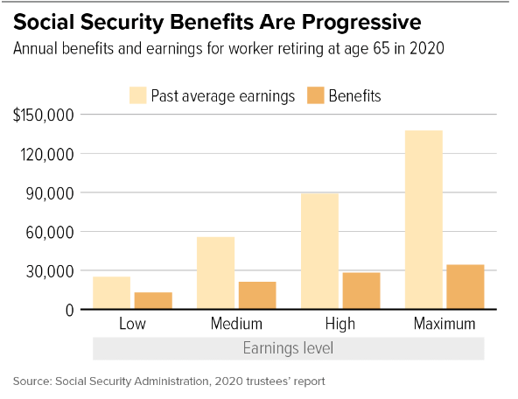
Social Security Benefits “By the Numbers”
2021 Maximum Benefit Amounts
  At FRA: $3,148
  At age 70: $3,895
Average Benefits
  Retiree: $1,546
  Retired Couple: $2,596
50% of couples and 70% of singles rely on Social Security for 50% of their income
21% of couples and 45% of singles rely on Social Security for 90% of their income

Slide 28
Windfall Elimination Provision
&
Government Pension Offset
Windfall Elimination Provision (WEP)
Applies to those who worked for certain state or local government agencies (including school systems)
  Specifically, work that was not covered by Social Security and for which Social Security tax was not withheld
  Earnings from this work will not show up in Social Security’s calculation, thus lowering the calculated benefit
  WEP in turn accounts for these earnings by applying a different calculation process to determine benefits
Earnings from Social Security-covered work can offset the WEP reduction

Slide 29
Windfall Elimination Provision
&
Government Pension Offset
Windfall Elimination Provision (WEP) Continued
WEP goes beyond the worker’s PIA
  The effect of WEP applies also to spousal benefits and other dependent benefits
  WEP does not apply to survivors’ benefits
To avoid the WEP reduction:
  You have the option to forfeit the government pension
    You can do this by withdrawing only the contributions you paid in before you become eligible for your pension.

Slide 30
Windfall Elimination Provision
&
Government Pension Offset
Windfall Elimination Provision (WEP) Continued
The maximum WEP reduction for someone turning 62 in 2021 is $498. This maximum reduction amount stays with you no matter what age you retire.
The WEP reduction can never be more than 50% of your pension.
You can reduce the WEP reduction or eliminate it all together through earning additional years of “substantial” earnings.
Each year of substantial earnings you have above 20 years reduces the reduction by an
additional 5%. https://www.ssa.gov/pubs/EN-05-10045.pdf
ELY | <= 20 | 21 | 22 | 23 | 24 | 25 | 26 | 27 | 28 | 29 | 30
2021 | $498 | $448 | $398 | $349 | $299 | $249 | $199 | $149 | $100 | $50 | $0

Slide 31
Windfall Elimination Provision
&
Government Pension Offset
Example of WEP Reduction of Worker with AIME of $1,500
Regular Formula WEP Formula
90% of first $996 $896.40 40% of first $996 $398.40
32% of earnings over $996 161.28 32% of earnings over $996 161.28
And through $6,002 And through $6,002
15% over $6,002 0.00 15% over $6,002 0.00
Total after rounding $1,057.60 Total after rounding $559.60
https://www.ssa.gov/benefits/retirement/planner/anyPiaWepjs04.html

Slide 32
Windfall Elimination Provision
&
Government Pension Offset
Government Pension Offset (GPO)
Applies to spouses who receive a pension from government work that was not covered by Social Security
  Applicable to spouses, divorced spouses, surviving spouses, surviving divorced spouses, and deemed spouses
  GPO results in Social Security spousal benefit reduction of $2 reduction for every $3 (or .667%)
To avoid the GPO reduction:
  For at least five years before you retire, work in a position where you are contributing to both Social Security and the same pension plan.

Slide 33
Medicare 2021
The standard Medicare Part B premium is $148.50
Part A deductible is $1,484
Part B deductible is $203
Do you need to take Medicare at 65?

Slide 34
Income Related Monthly Adjustment Amount aka IRMAA
If your yearly income in 2019 (for what you pay in 2021) was |  |  | You pay each month (in 2021)
File individual tax return | File joint tax return | File married & separate tax return
$88,000 or less | $176,000 or less | $88,000 or less | $148.50 | your plan premium
above $88,000 up to $111,000 | above $176,000 up to $222,000 | Not applicable | $207.90 | $12.30 + your plan premium
above $111,000 up to $138,000 | above $222,000 up to $276,000 | Not applicable | $297.00 | $31.80 + your plan premium
above $138,000 up to $165,000 | above $276,000 up to $330,000 | Not applicable | $386.10 | $51.20 + your plan premium
above $165,000 and less than $500,000 | above $330,000 and less than $750,000 | above $88,000 and less than $412,000 | $475.20 | $70.70 + your plan premium
$500,000 or above | $750,000 and above | $412,000 and above | $504.90 | $77.10 + your plan premium

Slide 35
Thank you for Joining Us!
Thank you for joining us this morning!
  We are planning for this type of seminar to be an on-going part of the Foundation’s seminar series
  Watch the Foundation’s “Events” page for future sessions
    www.AmacFoundation.org/Events
Our Social Security Advisory Service is available free-to-the public anytime
  Visit www.AmacFoundation.org/Services for direction
To stay current on what’s happening in Social Security and Medicare, visit our two information-packed websites:
  www.SocialSecurityReport.org
  www.MedicareReport.org

Slide 36

Thank you for Joining Us!

